Slide 1
Object Oriented Analysis & Design Module-5 (RL 5.2.4)
Harvinder S Jabbal

Slide 2
Guidelines to draw Class Diagram

Slide 3
Guideline for Classes
Put common terminology for names
Choose complete singular nouns over class names
Name operations with a strong verb
Name attributes with a domain-based noun
Do not model scaffolding code.
Never show classes with just two compartments
Label uncommon class compartments
Include an ellipsis ( … ) at the end of incomplete lists

Slide 4
Guidelines (cont.)
List static operations/ attributes before instance operations/attributes
List operations/attributes in decreasing visibility
For parameters that are objects, only list their type
Develop consistent method signatures
Avoid stereotypes implied by language naming conventions
Indicate exceptions in an operation’s property string. Exceptions can be indicated with a UML property string.

Slide 5
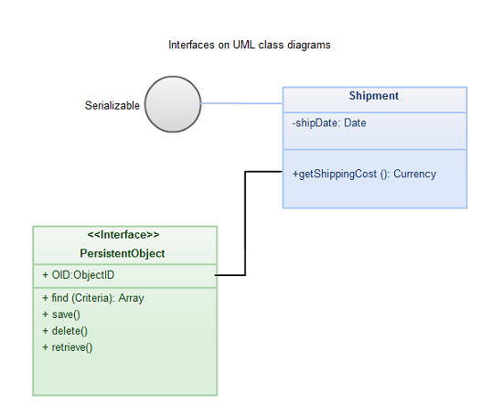
Interfaces
An interface can be defined as collection of operation signature and/or attribute definitions that ideally defines a cohesive set of behaviors.

Slide 6
Interfaces
In order to realize an interface, a class or component should use the operations and attributes that are defined by the interface.
Any given class or component may use zero or more interfaces and one or more classes or components can use the same interface.
Interfaces are implemented, “realized” in UML parlance, by classes and components.

Slide 7
Guideline for Interfaces
Interface definitions must reflect implementation language constraints.
In the example, you see that a standard class box has been used to define the interface PersistentObject (note the use of the <<interface>> stereotype).
Name interfaces according to language naming conventions
Apply “Lollipop” notation to indicate that a class realizes an interface
Define interfaces separately from your classes
Do not model the operations and attributes of an interface in your classes. In the above image, you’ll notice that the shipment class does not include the attributes or operations defined by the interfaces that it realizes
Consider an interface to be a contract

Slide 8
Acknowledgement
Slides are based on Course Text Books:
Applying UMP and Patterns (An Introduction to Object-Oriented Analysis and Design and Iterative Development) : Craig Larman
UMP Distilled (A Brief Guide to the Standard Object Modeling Langauge) : Martin Fowler
Design Patterns (Elements of Reusable Object-Oriented Software) : Erich Gama | Richard Helm | Rapph Johnson | John Vlissides alias GoF.
http://creately.com/diagram-type/article/simple-guidelines-drawing-uml-class-diagrams

